Slide 1

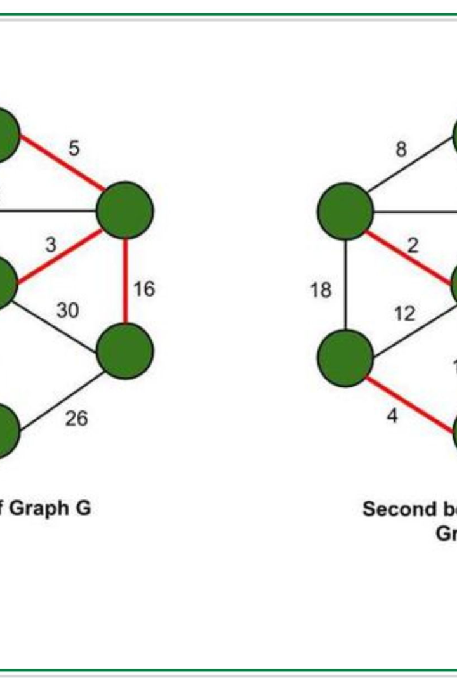

SPANNING TREES IN GRAPH THEORY
In this presentation, we'll explore the fascinating world of spanning trees and learn how they're used to solve real-world problems.
by DESIGN ALL

Slide 2




What Are Spanning Trees?
A spanning tree is a subgraph that contains all the vertices of the original graph without any cycles. In other words, it's a tree that touches every node of a network without forming any closed loops.
Tree-Like Structure
Useful for Searching
Network Design
Electronic Circuitry
A spanning tree has a tree-like structure, which makes it easy to visualize and understand.
Spanning trees are useful for searching, as they allow us to find the shortest path between two nodes in a network.
They're also used in network design to ensure that every node can be reached efficiently.
In electronic circuit design, spanning trees are used to connect all the components with the minimum amount of wire or trace.

Slide 3
Algorithmic Approaches
1
2
3
4
Depth-First Search (DFS)
Breadth-First Search (BFS)
Kruskal's Algorithm
Prim's Algorithm
Prim's algorithm builds the tree one vertex at a time while keeping the weight minimal.
One popular algorithm is DFS, which traverses the graph in a depth-first manner to construct the spanning tree.
BFS is another approach that explores the graph layer by layer to build the spanning tree.
Another algorithm is Kruskal's, which finds the minimum-weight edges in the graph to form the spanning tree.

Slide 4
Properties of Spanning Trees
Number of Edges
Cut Property
Cycle Property
A spanning tree has n-1 edges, where n is the number of nodes in the graph.
If we remove any edge from the spanning tree, it splits the tree into two or more disconnected components.
Any cycle in the graph cannot be part of the spanning tree since it would no longer be a tree.

Slide 5
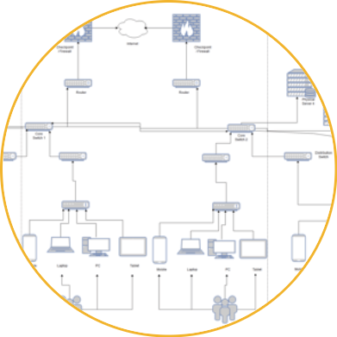
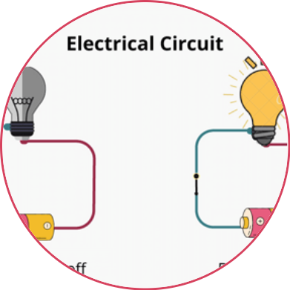

Applications of Spanning Trees
Network Design
Electric Circuitry
Image Segmentation
Spanning trees are used for designing maps of network communication, ensuring that data packets can flow from every node to the rest of the network.
In electronics, spanning trees are used for connecting electronic components with minimal wiring, ensuring efficient and cheap circuitry.
Image segmentation algorithms use the minimum spanning tree of a pixel grid to separate an image into different regions based on color.

Slide 6

Conclusion
Through our exploration of spanning trees in graph theory, we've seen how these simple objects can have profound implications for real-world problems, from network design to image segmentation. They're a powerful tool for understanding the structure of complex systems and developing efficient algorithms.

